Slide 1


Propensity score in ayurveda
Vinay Mahajan, Ashwini Mathur
Novartis Pharmaceuticals, Hyderabad
Chennai 2013

Slide 2
Disclaimer:
“The opinions expressed in this presentation and on the following slides are solely those of the presenter and not necessarily those of Novartis. Novartis does not guarantee the accuracy or reliability of the information provided herein.”
Some of the material has been obtained from internet and due credit has been given in the references
All the analysis has been executed using R software which is a freeware

Slide 3
Agenda
Propensity score method
Osteoporosis data example
Simulate data for ayurvedic trial
  Categorical data
  Continuous data
Simulation results
Ongoing work

Slide 4
Propensity Score Method – Background
Propensity scores, a method to reduce potential bias in observational studies and to balance observed baseline covariates in two treatment groups.
Propensity score: numerous covariates that can be condensed into a single scalar variable.
Once estimated, propensitiy scores can be used for analyses of outcomes as covariates in multivariate models, as matching factors, or to define strata for separate analysis.
Rosenbaum PR, Rubin DB. The central role of the propensity score in observational studies for causal effects. Biometrika 1983;70:41-55

Slide 5
Propensity Score Method – pictorial representation
☺ ☺ ☻ ☺ ☺ ☺ ☻ ☺ ☺ ☺
☺ ☺ ☺ ☻ ☺ ☺ ☺ ☻ ☻ ☺
☻ ☺ ☺ ☺ ☺ ☺ ☺ ☺
☺ ☺ ☻ ☺ ☻ ☻
Biased treatment difference
☺ ☺ ☻ ☺ ☺ ☺ ☻ ☺ ☺ ☺
☺ ☺ ☺ ☻ ☺ ☺ ☺ ☻ ☻ ☺
☻ ☺ ☺ ☺ ☺ ☺ ☺ ☺
☺ ☺ ☻ ☺ ☻ ☻
Treatment A
Outcome affected by baseline characteristics
How to reduce the bias
☻ ☺ ☻ ☻ ☻ ☺ ☻ ☺ ☺ ☻ ☻ ☻ ☻ ☺
☻ ☺ ☻ ☻ ☺ ☻☻ ☻ ☺
☻ ☺ ☻ ☻ ☻ ☺ ☻ ☺ ☺ ☻ ☻ ☻ ☻ ☺
☻ ☺ ☻ ☻ ☺ ☻☻ ☻ ☺
Treatment B
Outcome affected by baseline characteristics
Identify the baseline variables which impact the outcome, create a model
using one of the following methods
(there could be many more)
Propensity Score Methods
Stratified Matching
Logistic regression
Discriminant analysis
Decision tree analysis
Use one of these methods to have comparison of similar patients
reduce the bias in the treatment estimate
Nearest neighbour Matching
Inverse Probability Treatment Weighting
Radius Matching
Propensity score
between 0 and 1
Kernel Matching
Use this processed data for statistical analysis
Mahalnobis Matching
Convert multiple dimension to a scalar variable
Caliper Matching

Slide 6
Propensity Score Estimation – Background
It is critical to understand outcome does not play any role in estimating the propensity score, only the covariates impact the estimate.
The goal is to find the best estimated probability of receiving a particular treatment,
Over parameter-zing is not a concern, on the other hand this method encourages use of many covariates which could be impacting the outcome – going closer to the real world experience.

Slide 7
Let us take a look at the Ayurvedic setting

Slide 8
Ayurveda: from diagnosis to health
In-depth consideration of patient specific factors & drug properties lead to effective treatment
Continuous Modern lab parameters
Categorical
Continuous
Indicated
Causes
Diet
Contraindicated
Pathogenesis
Disease
Indicated
Symptoms
Lifestyle
No Symptoms
Contraindicated
Affecting factors
Single Drug
Homeostasis
Medicines
Formulations
Relief
Health
Precise
Diagnosis
Customized
Treatment
Good QoL
Constitution
Indicated
Tranquil mind
Systems & organs
Panchakarma
Contraindicated
Age
Well Being
Season
Psychological
Counseling
Strength
Patient
Metabolic status
Other Rx
Non-Drug
Tolerance
Individualization
Generalization
Surroundings
Diet
Dr. Girish Tillu, Pune.

Slide 9
All Data – Osteoporosis
Calculation of t-score as treatment variable
The National Health and Nutrition Examination Survey (NHANES)
Data are provided for 5,935 individuals who had a DXA scan.
There are 54 variables in the dataset, which includes non-bone density risk factors, BMD measurements, and information about fractures of the hip, wrist, and spine. Survey weights and sampling unit information is also included.
Thanks to Dr. Lisa Lix of the School of Public Health at the University of Saskatchewan for preparing the dataset for use. Please address your queries to lisa.lix@usask.ca.

Slide 10
Variables in the dataset
SEQN | Unique ID number assigned to each sample person | DXXOFBMD | Total femur BMD (g/cm2) | MCQ160A | Doctor ever said you have arthritis | OSQ010C | Broken or fractured spine | DBQ229 | Regular milk use 5 times per week
ALQ101 | Had at least 12 alcoholic drinks in the last year | DXXNKBMD | Femoral neck BMD (g/cm2) | MCQ180A | Age when told you had arthritis | RIAGENDR | Gender | DIQ010 | Doctor told you have diabetes
ALQ130 | Average number of alcohol drinks/day in the last 12 months | DXXTRBMD | Trochanter BMD (g/cm2) | MCQ190 | Type of arthritis | RIDAGEYR | Age (in years) | DID040 | Age when first told you have diabetes
ALQ140Q | Number of days having 5+ drinks in the last 12 months | DXXINBMD | Intertrochanter BMD (g/cm2) | MCQ160C | Doctor ever said you had coronary heart disease | RIDRETH1 | Race/ethnicity | DIQ220 | When was diabetes diagnosed
BMXBMI | Body mass index | DXXWDBMD | Ward’s triangle BMD (g/cm2) | MCQ180C | Age when told you had coronary heart disease | WHD020 | Current self-report weight (pounds) | DXXL2BMD | L2 BMD (g/cm2)
DBQ197 | Past 30 day milk consumption | DXXL1BMD | L1 BMD (g/cm2) | MCQ160L | Ever told you had any liver condition | WHD110 | Self-reported weight 10 years ago | DXXL3BMD | L3 BMD (g/cm2)
OSQ010A | Broken or fractured hip | MCQ180L | Age when told you had a liver condition | MCQ170L | Do you still have a liver condition | WHD140 | Greatest self-reported weight; does not include weight during pregnancy | DXXL4BMD | L4 BMD (g/cm2)
SDMVSTRA | Masked variance unit pseudo-stratum variable for variance estimation | OSQ010B | Broken or fractured wrist | SDMVPSU | Masked variance pseudo PSU variable for variance estimation | WTMEC2YR | Full 2 year sample weight for individuals with a medical examination (MEC) | DXXOSBMD | Total spine BMD (g/cm2)

Slide 11
Creation of comparison groups
T-score values
Treatment variable:
  Mean / SD for each BMD with White female 20-29 as reference
  T-score = ( Actual BMD – Mean BMD ) / SD BMD
  T-score classified into > -1 vs. others. [binary variable for treatment]
Many BMD scores are present in the data: the analysis is based on Total femur BMD (g/cm2) [DXXOFBMD]
Outcome variable:
  Any Fracture “Yes / No” variable based on fractured – Yes hip OR wrist OR spine

Slide 12
Creation of comparison groups
T-score values
Analysis:
  Take a look at the basic demographic table
  Compare 2 groups and check the risk of having any fracture
  Logistic regression to get odds ratio

Slide 13
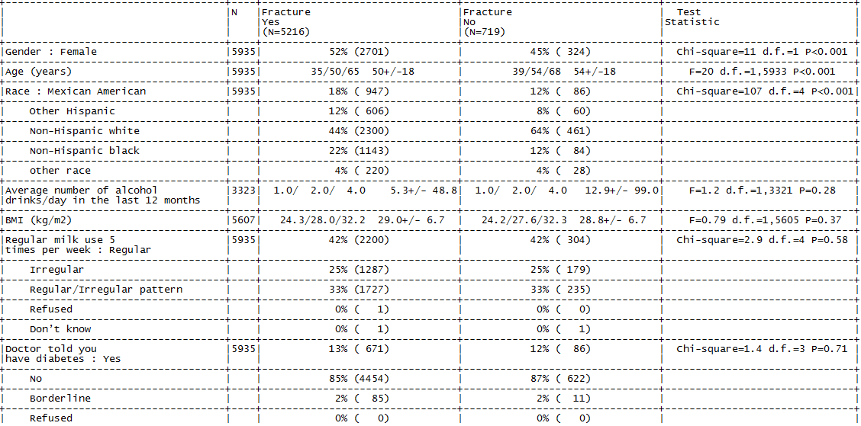
All data table (1/2)
Demographic

Slide 14
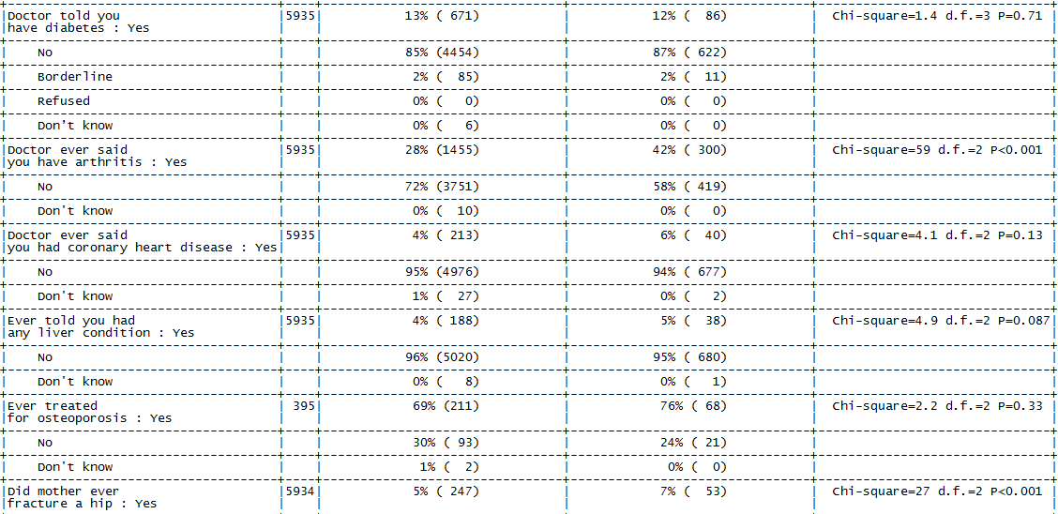
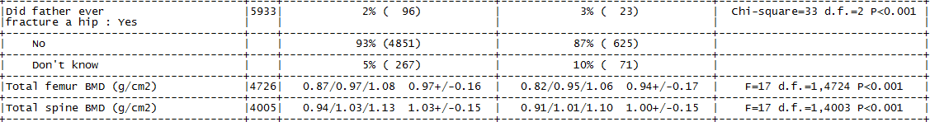
All data table (2/2)
Demographic
| Presentation Title | Presenter Name | Date | Subject | Business Use Only

Slide 15
All data table
Baseline characteristics are different
  Age
  Sex
  Race
  Having arthritis
  Mother having hip fracture
  Father having hip fracture
  BMD scores

Slide 16
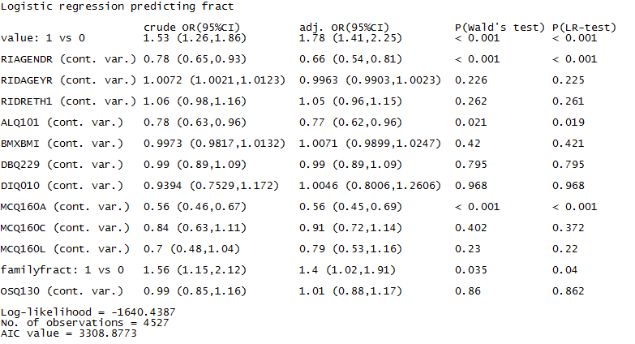
Logistic regression analysis – on all data
Odds of having any fracture given the baseline characteristics

Slide 17
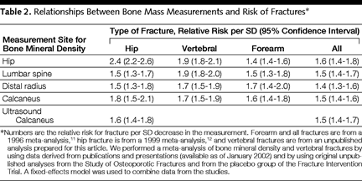
What is in the literature (1/3)
Odds estimated for t-score comparison (change by 1 sd)
(2) TUCKER, G., METCALFE, A., PEARCE, C.B., NEED, A.G., DICK, I.M., PRINCE, R.L. & NORDIN, B.E.C. (2007). The importance of calculating absolute rather than relative fracture risk. Bone, 41(6), 937-941.
Published in Bone
Abstract .
... This concept is illustrated in a prospective study of 1098 women over age 69 followed for 6 years in a calcium trial in which hip BMD was measured in the second year. 304 Women (27.6%) had prevalent fractures and 198 (18.1%) incident fractures with a significant association between them (P 0.005). Age-adjusted hip BMD and T-score were significantly lower in those with prevalent fractures than in those without (P 0.003) and significantly lower in those with incident fractures than in those without (P 0.001).When the data were analysed by univariate logistic regression, the fracture odds at zero T-score were 0.130 and the rise in odds for each unit fall in hip T-score was 1.55. When these odds were converted to risks, there was a progressive divergence between odds and risk at T-scores below zero. Multiple logistic regression yielded significant odds ratios of 1.47 for each 5-year increase in age, 1.47 for prevalent fracture and 1.49 for each unit fall in hip T-score. ...
(1) Clinical Use of Bone Densitometry: Scientific Review
http://jama.jamanetwork.com/article.aspx?articleid=195421

Slide 18
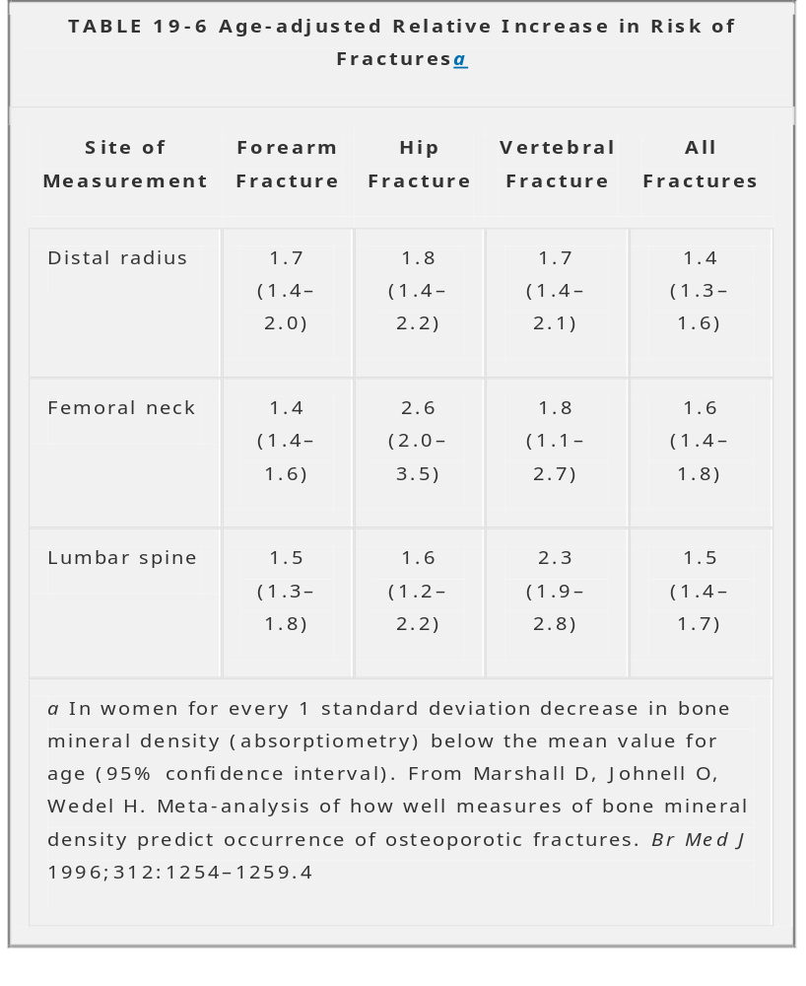
What is in the literature (2/3)
Odds estimated for t-score comparison (change by 1 sd)
(3) Bone mineral density and vertebral fractures in men.
Legrand E, Chappard D, Pascaretti C, Duquenne M, Rondeau C, Simon Y, Rohmer V, Basle MF, Audran M.
Source Service de Rhumatologie, CHU d'Angers, France.
Abstract
... In the present study, 200 men (mean age 54.7 years) with lumbar osteopenia (T-score < -1.5) were recruited to examine the relationships between spine BMD and hip BMD and the associations of BMD with vertebral fractures. Lumbar BMD was assessed from L2 to L4, in the anteroposterior view, using dual-energy X-ray densitometry. At the upper left femur, hip BMD was measured at five regions of interest: femoral neck, trochanter, intertrochanter, Ward's triangle and total hip. Spinal radiographs were analyzed independently by two trained investigators and vertebral fracture was defined as a reduction of at least 20% in the anterior, middle or posterior vertebral height. Spinal radiographs evidenced at least one vertebral crush fracture in 119 patients (59.5%). The results of logistic regression showed that age, femoral and spine BMDs were significant predictors of the presence of a vertebral fracture. Odds ratios for a decrease of 1 standard deviation ranged from 1.8 (1.3-2.8) for spine BMD to 2.3 (1.5-3.6) for total hip BMD. For multiple fractures odds ratios ranged from 1.7 (1.1-2.5) for spine BMD to 2.6 (1.7-4.3) for total hip BMD.
...
(4) http://www.msdlatinamerica.com/ebooks/RockwoodGreensFracturesinAdults/sid522151.html#T6-19:

Slide 19
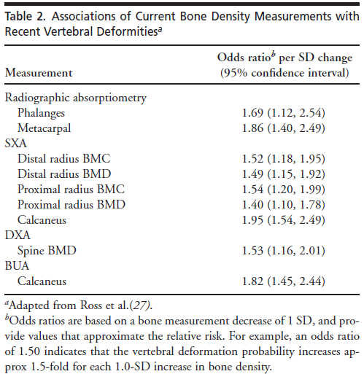
What is in the literature (3/3)
Odds estimated for t-score comparison (change by 1 sd)
Literature:
Odds ratios are going from 1.5 to 1.9
Our estimate: 1.78
Is this over-estimation or under-estimation?

Slide 20
Ayurvedic clinical trials
What question needs to be answered?
  Classical texts
  New method based on classical texts
  New formulation
  Comparison of ayurvedic medicine vs. western medicine
  Is it to check safety or efficacy of the study?
Types of designs to be used
  RCTs?
  Observational studies

Slide 21
Simulation set-up for ayurvedic study
Simulate data to get odds ratio of 1.7
Data with categorical variables
x1, x2, x3, x4, x5, x6 x7, x8, x9 | ~ Bernoulli (0.5) ~ Normal (0, 1) ~ Bernoulli (0.5)
Patients in each study | 200, 400, 600, 800, 1000, 2000, 5000
Number of studies | 400 – simulation runs
Confounding variables | x1, x2, x3, x4, x5
Only treatment related variables | x7, x8
Only outcome related variables | x6
Variable not related to both | x9
True treatment equation | b0 + b1 * x1 + b2 * x2 + b3 * x4 + b4 * x5 + b5 * x7 + b6 * x8
True outcome equation | a0 + c * trt + a1 * x1 + a2 * x2 + a3 * x3 + a4 * x4 + a5 * x5 + a6 * x6
References:
The performance of different propensity score methods for estimating marginal odds ratios Peter C. Austin 2007
Propensity score methods in observational studies Susanne Stampf 2010
Measuring balance and model selection in propensity score methods Svetlana V. Belitser1 et al. 2011

Slide 22
Simulation set-up for ayurvedic study
Simulate the data based on pre-defined equations
Estimate the Propensity score using logistic regression
  Use full model: trt0 ~ x1 + x2 + x3 + x4 + x5 + x6 + x7 + x8 + x9
Use the following matching methods and estimate odds ratio
  Raw, N:N 1:1 w/o caliper, N:N 2:1 w/o caliper, sub-classification
  N:N 1:1 with caliper 0.1, N:N 1:1 with caliper 0.2,
  Inverse probability weighting treatment method (IPTW)
Choose the model with the least MSE value
Identify the number of times a method gets selected as the best method
Calculate the average values for Odds ratio, MSE and Bias
Bias = Truth – Estimate

Slide 23
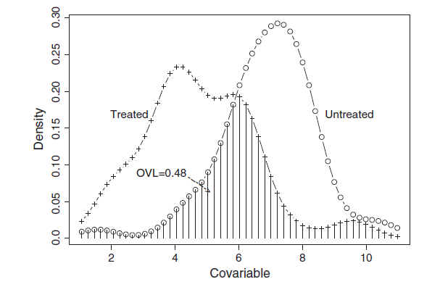
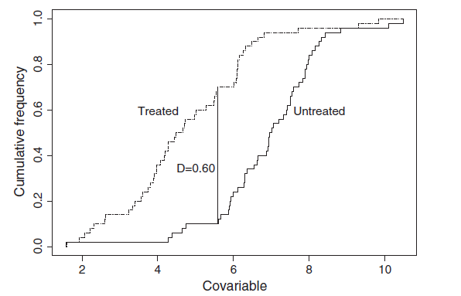
Balance measures for 9 variables
Compare to see if baselines are similar or not – 2 methods
Overlapping coefficient
0 <= OVL <= 1
~ 0 : less balance
~ 1 : very good balance
Kolmogorov Smirnov distance
0 <= KS <= 1
~ 0 : very good balance
~ 1 : less balance
+ some more methods could be employed: t-test, standardized difference, Anderson-Darling test, etc.
Measuring balance and model selection in propensity score methods Svetlana V. Belitser1 et al. 2011

Slide 24
Balance measures for 9 variables
Compare to see if baselines are similar or not – 2 methods
Method | Size | x1 | x2 | x3 | x4 | x5 | x6 | x7 | x8 | x9
OVL | 500 | 0.67 | 0.86 | 0.93 | 0.79 | 0.9 | 0.93 | 0.67 | 0.85 | 0.93
 | 2000 | 0.67 | 0.86 | 0.96 | 0.79 | 0.9 | 0.94 | 0.66 | 0.86 | 0.96
 | 5000 | 0.66 | 0.86 | 0.97 | 0.79 | 0.9 | 0.94 | 0.66 | 0.86 | 0.97
KS | 500 | 0.37 | 0.18 | 0.08 | 0.21 | 0.09 | 0.04 | 0.37 | 0.18 | 0.08
 | 2000 | 0.36 | 0.16 | 0.04 | 0.21 | 0.09 | 0.02 | 0.36 | 0.16 | 0.04
 | 5000 | 0.35 | 0.15 | 0.03 | 0.21 | 0.09 | 0.01 | 0.35 | 0.15 | 0.03
The covariate balance is quite high
would propensity score method give better results than logistic regression?

Slide 25
Simulation results – best method based on MSE
400 simulation runs, Pscore est: trt0 ~ x1 + x2 + x3 + x4 + x5 + x6 + x7 + x8 + x9
Method | Number of times chosen / 400 | Patients | Effective sample size | Mean OR | Mean MSE | Mean Bias
Raw | 146 | 400 | 400 | 1.73 | 1.23 | 1.01
 | 143 | 600 | 600 | 1.77 | 1.14 | 1.01
 | 155 | 800 | 800 | 1.79 | 1.11 | 1.01
 | 146 | 1000 | 1000 | 1.68 | 1.08 | 1.00
 | 147 | 2000 | 2000 | 1.72 | 1.04 | 1.00
 | 142 | 5000 | 5000 | 1.72 | 1.04 | 1.00
N:N 1:1 w/o caliper | 17 | 400 | 270 | 1.88 | 1.28 | 0.91
 | 15 | 600 | 420 | 1.65 | 1.16 | 0.96
 | 18 | 800 | 536 | 1.65 | 1.12 | 0.98
 | 10 | 1000 | 750 | 1.84 | 1.09 | 1.02
 | 12 | 2000 | 1380 | 1.70 | 1.04 | 0.99
 | 11 | 5000 | 3488 | 1.75 | 1.02 | 0.99

Slide 26
Simulation results – best method based on MSE
400 simulation runs, Pscore est: trt0 ~ x1 + x2 + x3 + x4 + x5 + x6 + x7 + x8 + x9
Method | Number of times chosen / 400 | Patients | Effective sample size | Mean OR | Mean MSE | Mean Bias
N:N 2:1 w/o caliper | 5 | 400 | 216 | 1.48 | 1.35 | 0.87
 | 6 | 600 | 318 | 1.79 | 1.21 | 0.98
 | 1 | 800 | 402 | 1.05 | 1.14 | 0.89
 | 5 | 1000 | 571 | 1.73 | 1.11 | 0.98
 | 5 | 2000 | 1057 | 1.80 | 1.05 | 1.01
 | 7 | 5000 | 2666 | 1.70 | 1.02 | 1.03
N:N 1:1 with caliper 0.1 | 1 | 400 | 144 | 0.70 | 1.32 | 0.86
 | 2 | 600 | 180 | 2.53 | 1.30 | 1.21
 | 3 | 800 | 232 | 1.52 | 1.17 | 0.93
 | 4 | 1000 | 362 | 1.63 | 1.13 | 1.02
 | 3 | 2000 | 1380 | 1.73 | 1.06 | 1.00
 | 5 | 5000 | 3488 | 1.60 | 1.02 | 0.99

Slide 27
Simulation results – best method based on MSE
400 simulation runs, Pscore est: trt0 ~ x1 + x2 + x3 + x4 + x5 + x6 + x7 + x8 + x9
Method | Number of times chosen / 400 | Patients | Effective sample size | Mean OR | Mean MSE | Mean Bias
N:N 1:1 with caliper 0.2 | 1 | 400 | 160 | 1.60 | 1.02 | 0.99
 | 2 | 600 | 188 | 2.10 | 1.25 | 1.09
 | 1 | 800 | 242 | 1.79 | 1.13 | 1.00
 | 1 | 1000 | 382 | 1.70 | 1.12 | 1.00
 | 3 | 2000 | 618 | 1.82 | 1.12 | 1.00
 | 6 | 5000 | 1724 | 1.77 | 1.02 | 1.00
IPTW - covariate | 56 | 400 | 400 | 1.60 | 1.02 | 0.99
 | 58 | 600 | 600 | 1.77 | 1.17 | 1.04
 | 54 | 800 | 800 | 1.75 | 1.12 | 1.01
 | 56 | 1000 | 1000 | 1.67 | 1.06 | 1.00
 | 61 | 2000 | 2000 | 1.72 | 1.04 | 1.01
 | 72 | 5000 | 5000 | 1.68 | 1.02 | 1.00

Slide 28
Simulation results – best method based on MSE
400 simulation runs, Pscore est: trt0 ~ x1 + x2 + x3 + x4 + x5 + x6 + x7 + x8 + x9
Method | Number of times chosen / 400 | Patients | Effective sample size | Mean OR | Mean MSE | Mean Bias
IPTW – weight | 159 | 400 | 400 | 1.60 | 1.02 | 1.00
 | 160 | 600 | 600 | 1.79 | 1.11 | 1.00
 | 152 | 800 | 800 | 1.73 | 1.07 | 1.00
 | 163 | 1000 | 1000 | 1.70 | 1.06 | 1.00
 | 142 | 2000 | 2000 | 1.73 | 1.03 | 1.01
 | 139 | 5000 | 5000 | 1.70 | 1.01 | 1.00
Subclass – 5 strata | 15 | 400 | 400 | 1.60 | 1.02 | 0.99
 | 14 | 600 | 600 | 1.79 | 1.11 | 1.00
 | 16 | 800 | 800 | 1.67 | 1.11 | 0.99
 | 15 | 1000 | 1000 | 1.75 | 1.09 | 1.01
 | 27 | 2000 | 2000 | 1.72 | 1.04 | 1.00
 | 18 | 5000 | 5000 | 1.70 | 1.02 | 1.00

Slide 29
Interpretation
The logistic regression and IPTW weighting had the least MSEs
In matching methods a lot of data gets dropped
Need to have a pre-defined rule
  Understanding the imbalance in the data
  Estimation of propensity score – variable selection
  Choosing a matching method
At what level of imbalance should propensity score method be employed? – ongoing work

Slide 30
Ongoing work
Simulation set-up with the following parameters
  Pre specified odds ratio of interest
  Proportion of patients in treatment groups
  Proportion of outcome in treatment groups
  Imbalance of baseline characteristic
Evaluation criteria for identifying balance across treatment groups
Evaluation of the propensity score model from many models
Identification of optimal method
Usage of the simulation set-up to determine sample size required using matching methods

Slide 31
Osteoporosis study results
Odds ratio with different methods
Method | OR | MSE | Effective sample size
Raw | 1.78 |  | 4527
N:N 1:1 w/o caliper | 1.99 | 3.28 | 2202
N:N 2:1 w/o caliper | 1.79 | 3.25 | 3303
Optimal | 1.87 | 3.22 | 2202
N:N 1:1 with caliper 0.1 | 1.86 | 3.22 | 1686
N:N 1:1 with caliper 0.2 | 1.88 | 3.25 | 1756
IPTW – covariate | 1.95 | 3.21 | 4527
IPTW – weight | 1.56 | 3.69 | 4527
Subclass – 5 | 1.74 | 3.23 | 4527

Slide 32
Thank you

